Slide 1

California’s
Quality Rating and Improvement System
And Local County Partners
Notes:
Suggested Speaker Notes:
Learning objectives:
Examine the benefits of quality rating and improvement systems (QRISs)
Gain greater understanding of QRISs in California
Gain greater understanding of QRIS resources at the state and county level

Slide 2
What is Quality?
“Quality early learning and care programs have environments, relationships, interactions, and activities to support all children’s growth and development to prepare them for success in school and life.”
Notes:
Suggested Speaker Notes
Begin by having students read this quote or read the quote aloud to students.
Optional Activity:
Have students reflect on what this quote means to them. What word, or words, from this quote is the most important to them? Have them share their important word(s) with a classmate.

Slide 3
Why Focus on Quality?
High quality in early childhood programs can support healthy development and learning:
Better outcomes for children as they enter elementary school
Reduced achievement gap
Improved outcomes for families
Notes:
Suggested Speaker Notes:
As early childhood educators and faculty, we have been working to improve and sustain high-quality programs for many years. But why? (Open up for a few replies.)
California is focusing on quality because high-quality early childhood programs can support healthy development and learning. Participating in high-quality early childhood programs results in:
Better outcomes for children as they enter elementary school
A reduced achievement gap later in school
Improved outcomes for families
References:
https://www.childtrends.org/publications/high-quality-preschool-can-support-healthy-development-and-learning
https://www.buildinitiative.org/blog/shifting-the-conversation-from-compliance-to-continuous-quality-improvement
Optional Discussion:
Ask students what they already know from other courses, workshops, readings, and so forth about quality early learning and care. (Purpose: Link to prior knowledge) Possible formats for discussion include:
Think, pair, share
Write down three quick thoughts
Optional Discussion:
For entry-level students: What is quality early learning? What are its key components and/or how do you define quality in early learning?
For more advanced students: How do you measure quality early learning? Or what aspects of quality can be measured and how? (Answers: quality learning environments, ERS, ratios, teacher education, quality interactions, CLASS, etc.)
Leading into next slides:
Online poll or show of hands: How familiar are you with Quality Counts California (QCC)?
Very familiar—I (or my child) go to a QCC program every day!
Somewhat familiar—I have heard about QCC, but I’m not sure exactly what it is.
Not at all familiar—I have never heard of QCC.
Acronym Buster—talk with a partner and determine what QCC and QRIS stand for.
KWL Chart about QRIS/QCC—Know, What to Know, Learned (return to chart at the end of the presentation)

Slide 4
Quality Rating and Improvement Systems (QRISs)
A QRIS is a systemic approach to assess, improve, and communicate the level of quality in early and school-age care and education programs.
The first statewide QRIS program began in 1998 in Oklahoma.
More than half of all states and the District of Columbia have QRISs.
Notes:
Suggested Speaker Notes:
Nationally, there is a movement of quality systems called quality rating and improvement systems, or QRISs.
A QRIS is a systemic approach to assess, improve, and communicate the level of quality in early and school-age care and education programs.
The first statewide QRIS program began in 1998 in Oklahoma.
More than half of all states and the District of Columbia have QRISs.

Slide 5
QRIS in California
Collaboration between First 5 California and the California Department of Education’s Early Learning and Care Division
State and local efforts to improve the quality of early learning and care programs for California’s children
Called Quality Counts California
(QCC)
Notes:
Suggested Speaker Notes:
In California the QRIS is a collaboration between First 5 California and the Department of Education’s Early Learning and Care Division.
The QRIS is implemented through a combination of state and local efforts to improve the quality of early learning and care programs for all of California’s children.
Some programs are statewide, while others are locally implemented.
California’s collaborative QRIS program is called Quality Counts California, or QCC.

Slide 6
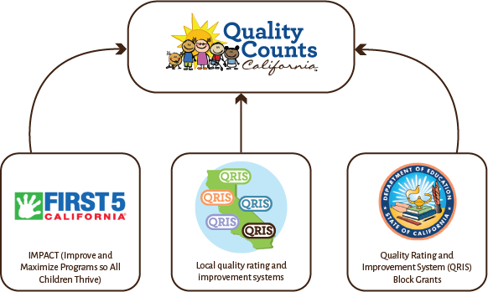
Quality Counts California
Notes:
Suggested Speaker Notes:
This graphic depicts the collaborative nature of Quality Counts California.
As you can see, Quality Counts California relies on all partners—First 5 California, the California Department of Education, and local QRIS partners—to implement the program.
Resource: https://qualitycountsca.net/policymakers/

Slide 7
Why Is QCC Important to Me?
Quality means better outcomes for children.
It provides opportunities for professional growth.
It provides opportunities for career advancement or different roles.
Becoming familiar with the various tools and materials can be helpful in my work.
Participation in QCC may be expected at places of employment.
Notes:
Suggested Speaker Notes:
Why should you as a student be aware of QCC in the state and community? Why is it important?
We know that quality means better outcomes for children. As a student and early childhood education professional, the various components of the local QRIS and Quality Counts California offer additional benefits to you:
It provides opportunities for professional growth.
It provides opportunities for career advancement or a different role (coach, family engagement specialist, family advocate, trainer, etc.).
Becoming familiar with various tools, approaches, and materials used in quality programs can also help in your work.
And participation may be expected of you at your current or future place of employment.

Slide 8
What Does QCC Do?
Provides access to tools and resources for quality partners
Links child care providers to resources
Informs parents and families about the importance of quality early learning
Offers information and research to help policymakers
Notes:
Suggested Speaker Notes:
Through its statewide and local initiatives and partners, Quality Counts California, or QCC, provides a variety of quality supports.
Quality Counts California:
Provides access to tools and resources for quality partners like QRIS administrators, coaches, trainers, and higher education faculty
Links child care providers to resources and support to assist them in their commitment to quality early learning and care
Informs parents and families about the importance of quality early learning and helps them identify quality early learning and care environments (i.e., family child care homes or child care centers)
Offers information and research to help policymakers communicate the value and importance of quality early learning and care
Optional Activity:
Have students go to the QCC website. Have one group find a resource for families, a second group find a resource for providers, and a third group find a resource for policymakers. Share with the whole group. (Purpose: Increase awareness of the website)

Slide 9
How Does QCC
Implement QRISs?
Supports a network of local QRISs
Ensures consistency and standardization statewide
Trains and supports assessors, coaches, and other quality support providers
Notes:
Suggested Speaker Notes:
How does QCC implement QRISs in California?
Throughout California, QRIS programs are implemented in a variety of ways:
QCC is an umbrella of support to the network of local QRISs.
QCC ensures consistency and standardization of QRIS programs statewide.
QCC also trains and supports assessors, coaches, and other quality support providers to allow for consistency across the state.
Next, we’ll talk about how these various components provide for standardization and consistency among various QRIS programs throughout California.
Resource: https://qualitycountsca.net/child-care-providers/

Slide 10
Quality Standards
QCC’s program standards cover three core areas:
Child Development and School Readiness
Teachers and Training
Program and Environment
These standards are reflected in the QCC Rating Matrix.
Notes:
Suggested Speaker Notes:
Quality Counts California, with its many partners including higher education faculty, developed the QCC quality standards.
The quality standards cover three core areas:
Child Development and School Readiness
Teachers and Training
Program and Environment
These standards are reflected in the QCC Rating Matrix: https://drive.google.com/file/d/1lSutvANj8pR3fTm2vY9s5lMcbXfRKGe8/view

Slide 11
Quality Assessments
A certified independent observer visits the early learning and care environment.
The observer measures the program using QCC standards of quality.
The observer provides feedback for potential areas of growth.
The program is awarded a rating.
Ratings are available to families to help them choose a program for their child.
Notes:
Suggested Speaker Notes:
One step in the process in any QRIS is conducting a quality assessment.
A local certified independent observer visits the early learning and care environment.
Using the standardized QCC Rating Matrix, the observer measures the program quality using the QCC standards of quality.
Programs are assessed using standardized quality assessment tools, such as the Environmental Rating Scales and the Classroom Assessment Scoring System (CLASS), and children’s files.
Based on the model utilized in the respective county or region, the observer then provides feedback and offers resources for potential areas of growth.
The program is also awarded a rating.
Ratings are typically made available to families to help them choose a program for their child.

Slide 12
Quality Improvement
Support
State and local quality improvement programs provide support for continuous growth and improvement.
Examples include:
QCC Family Engagement Toolkit
Dual Language Learner Resource Guide
Local coaching programs
Notes:
Suggested Speaker Notes:
State and local programs provide opportunities for quality improvement and growth based on the quality improvement assessment.
Examples of statewide and local initiatives include:
QCC Family Engagement Toolkit (statewide)
Dual Language Learner Resource Guide (statewide)
Local coaching programs that can offer coaching support to programs based on program needs
Are there other local programs you know of that may benefit programs hoping to improve quality?
Resource: https://qualitycountsca.net/child-care-providers/

Slide 13
Professional Development
Professional development is offered on a range of topics through both local and statewide initiatives.
Many opportunities provide professional growth hours toward child development permits.
Community colleges and universities provide valuable professional development.
Notes:
Suggested Speaker Notes:
Professional development plays a key role in supporting quality improvement.
Professional development is offered on a range of topics both locally and statewide.
Many of the professional development opportunities provide professional growth hours toward child development permits.
Community colleges and universities provide valuable professional development through unit-bearing college coursework and conferences supporting quality improvement year-round.

Slide 14
QCC Professional Development Opportunities
California Preschool Instructional Network (CPIN)
Program for Infant/Toddler Care (PITC)
Classroom Assessment Scoring System (CLASS)
Early Childhood Environmental Rating Scales
Ages and Stages Questionnaire/SE (ASQ/ASQ-SE)
Strengthening Families
CSEFEL Teaching Pyramid Framework
California Preschool Learning Foundations and Framework
California Infant/Toddler Learning and
Development Foundations and Framework
Desired Results Developmental Profile
Notes:
Suggested Speaker Notes:
Here is a sampling of the professional development initiatives and training opportunities available through Quality Counts California:
California Preschool Instructional Network (CPIN)
Program for Infant/Toddler Care (PITC)
Classroom Assessment Scoring System (CLASS)
Early Childhood Environmental Rating Scales
Ages and Stages Questionnaire/SE (ASQ/ASQ-SE)
Strengthening Families
CSEFEL Teaching Pyramid Framework
California Preschool Learning Foundations and Framework
California Infant/Toddler Learning and Development Foundations and Framework
Desired Results Developmental Profile

Slide 15
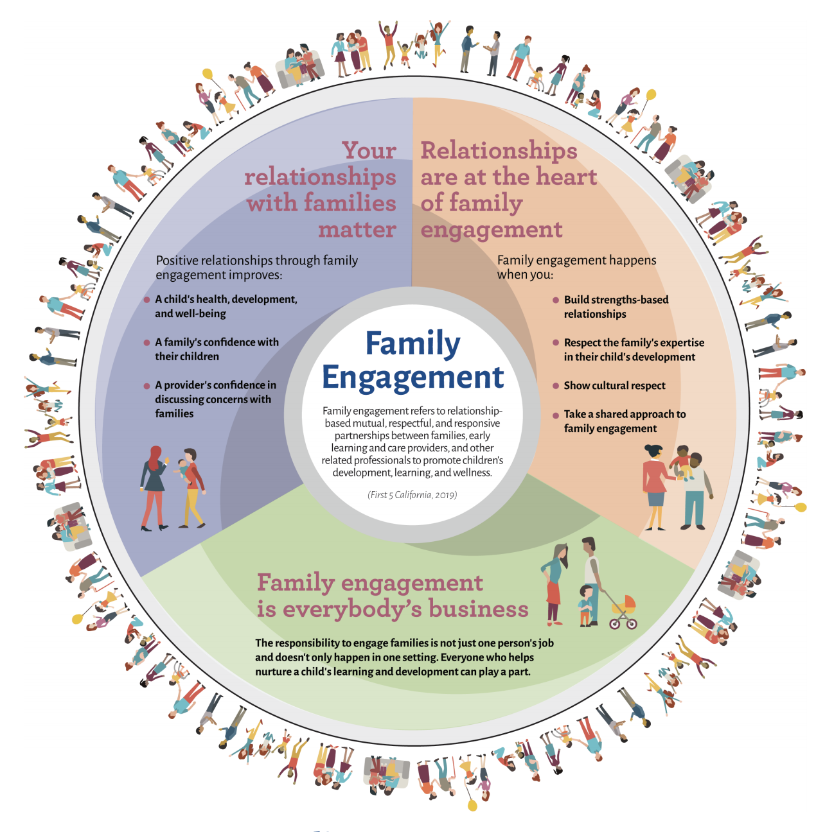
Family Engagement
Notes:
Suggested Speaker Notes:
A key component of Quality Counts California is family engagement. Not only is it part of the program observation and quality standards, but it is also key to providing families access to information and quality programs.
Note: You may want to walk through each component of the graphic or skip to the next slide, which is specific to early childhood education providers.

Slide 16
Family Engagement (cont.)
Family engagement can improve:
A child’s health, development, and well-being
A family’s confidence and relationship with their children
A provider’s confidence in
discussing concerns with families
Notes:
Suggested Speaker Notes:
As an early childhood education provider, family engagement can improve:
A child’s health, development, and well-being
A family’s confidence and relationships with their children
A provider’s confidence in discussing concerns with families

Slide 17
QCC Family Engagement Toolkit
Helps early childhood education professionals build relationships with children and families
Includes tips and strategies to engage families in meaningful ways
Is available in English and
Spanish
Notes:
Suggested Speaker Notes:
The QCC Family Engagement Toolkit is available online: https://www.qualitycountsca.net/child-care-providers/family-engagement/
Helps early childhood education professionals build relationships with children and families
Includes tips and strategies to engage families in meaningful ways
Is available in English and Spanish
You may choose to show to students the two helpful videos available at the link provided.
In addition, the toolkit itself is available online with modules to be completed online independently or as a group. https://www.qualitycountsca.net/child-care-providers/family-engagement/family-engagement-toolkit/

Slide 18
Family Resources
Family-specific QCC webpage:
  How to choose a quality program
  Finding early learning and care programs
  Using county resource and referral programs
Notes:
Suggested Speaker Notes:
Quality Counts California also provides information to families. The family-specific webpage provides information about how to choose a quality program, finding early learning and care programs, and how to use a county resource and referral program.
Resource: https://qualitycountsca.net/families/
In addition, participating counties also provide lists on their websites of early childhood programs participating in the local QRIS program.

Slide 19
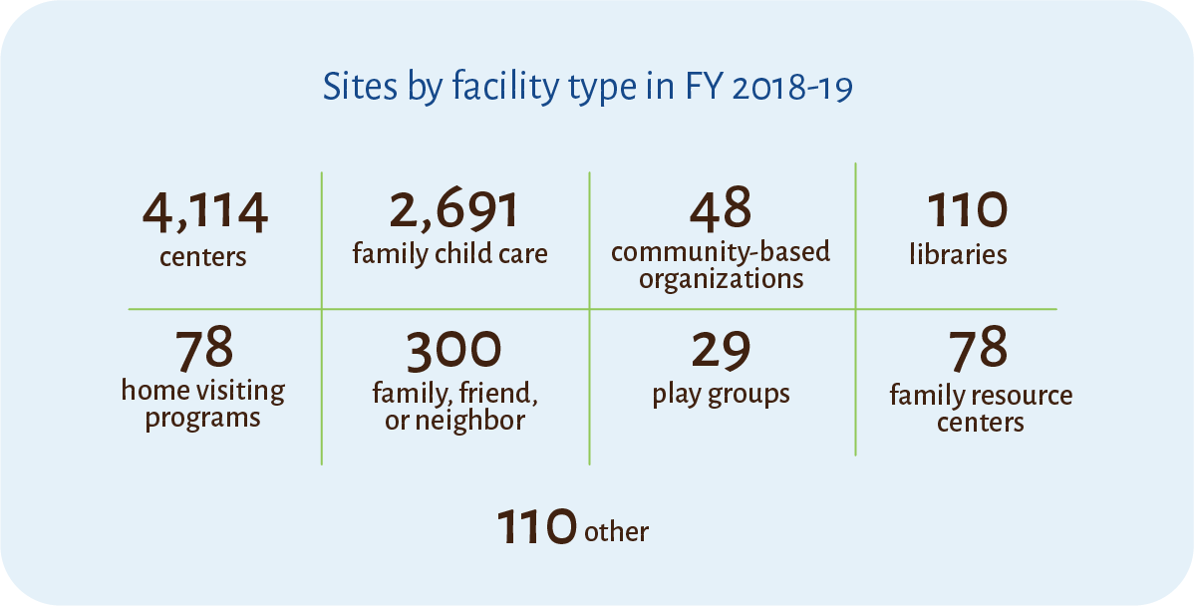
Participation in QRISs in California by Facility Type
Notes:
Suggested Speaker Notes:
Participation in QRISs is open to early learning programs throughout California. Each county or region manages the local QRIS program.
As you can see, in 2018–19, over 7,500 programs participated statewide, including center-based; family child care; family, friend, and neighbor programs; and others.

Slide 20
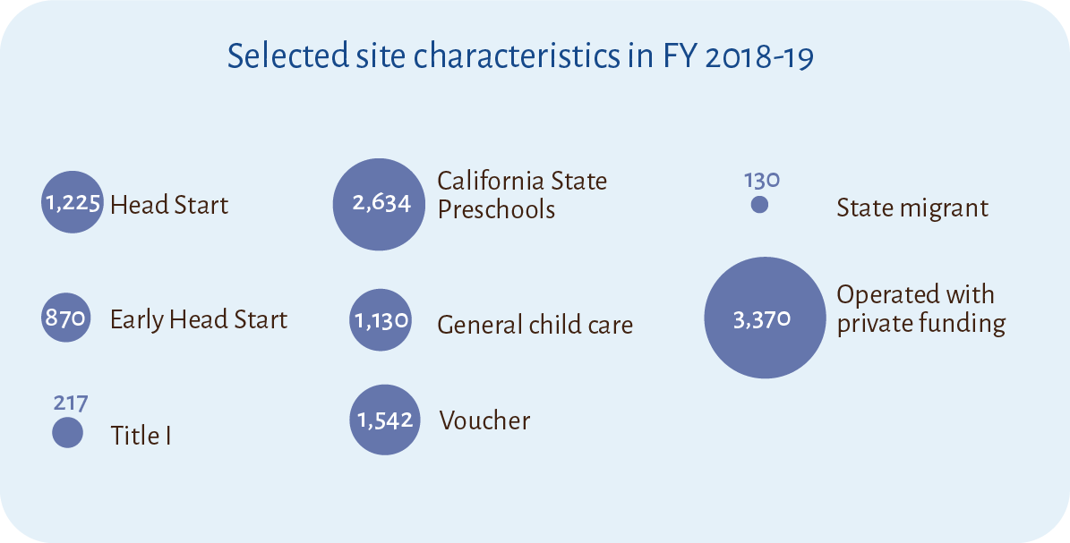
QRIS Site Characteristics
Notes:
Suggested Speaker Notes:
The center-based and family child care programs represented a variety of program types as depicted in this slide, including:
Head Start
State Preschool
Migrant
Early Head Start
Private programs
And others

Slide 21
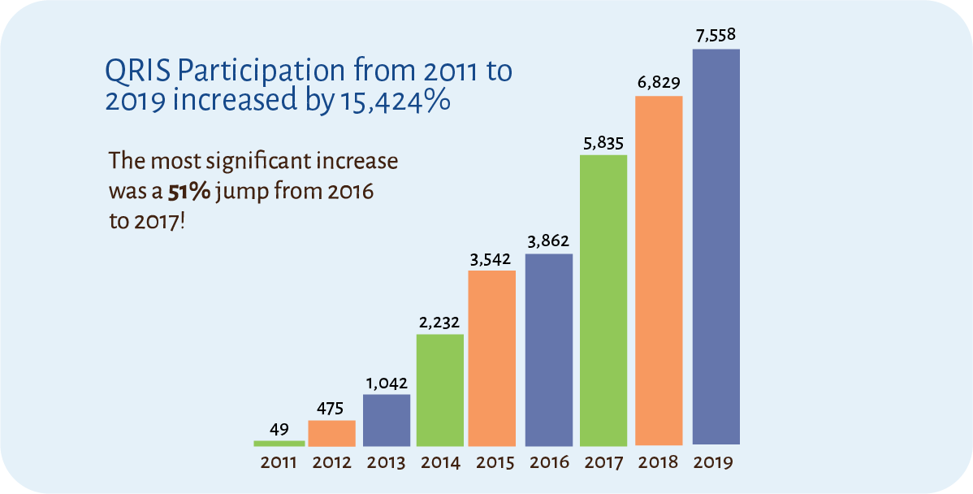
QRIS Participation
Notes:
Suggested Speaker Notes:
In 2011, 49 programs participated in California’s QRIS program.
In 2019, over 7,558 programs participated. That’s an increase of over 15,000%.

Slide 22
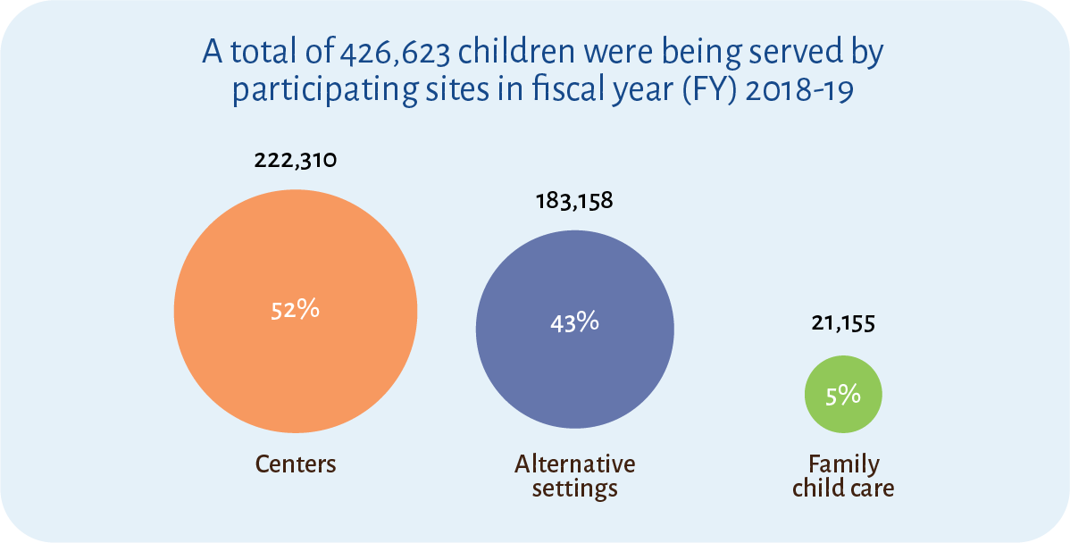
Children Served by QRISs
Notes:
Suggested Speaker Notes:
Most importantly, last year alone, a total of 426,623 children were served in the programs participating in quality improvement efforts in California!

Slide 23
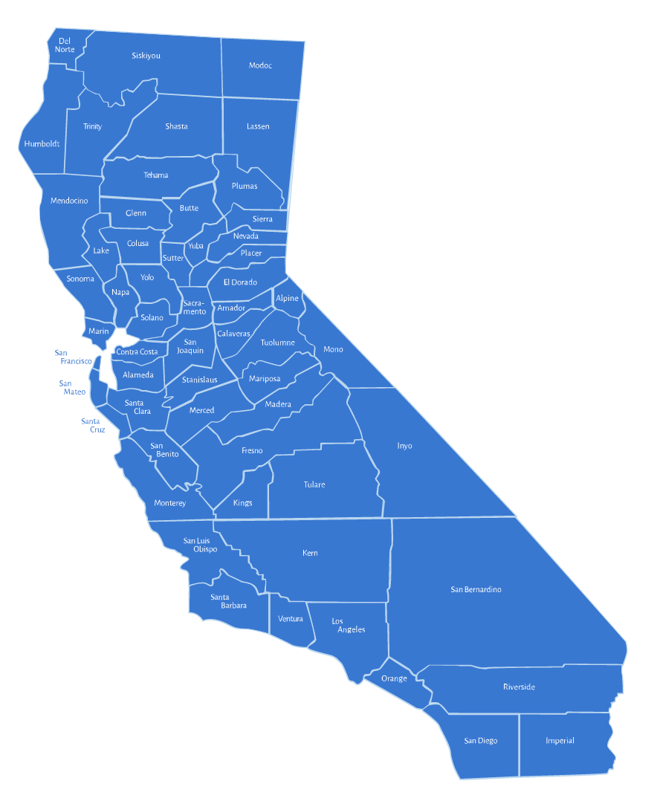
Find Your Local QRIS
Notes:
Suggested Speaker Notes:
As mentioned previously, Quality Counts California and the QRIS efforts statewide are implemented through local efforts.
Each county manages a local webpage with information about local QRIS-related activities, programs, and supports.
Resource: https://www.qualitycountsca.net/quality-partners/county-program-profile-and-services/
Optional Activity:
Have students find their county’s website. Ask students to find information that parents/families could use. At some colleges all students will locate the same website. At other colleges, students will locate multiple websites. Share out. (Purpose: Increase awareness of local websites and resources)

Slide 24

Thank You
[Insert Local First 5/QCC info]
Quality Counts California
https://www.qualitycountsca.net/
Funded and Facilitated by:
& Local County Partners
Notes:
Suggested Speaker Notes:
Encourage students to visit the following webpage(s):
(You may want to include local First 5/QCC information if applicable.)
Quality Counts California webpage: https://www.qualitycountsca.net/
Optional Summary and Review Activities (Purpose: Gauge students’ understanding of QRISs in California):
If using a KWL Chart, have students describe what they learned.
Have students work in small groups to draft an “elevator pitch” about QCC for specific audiences. Have students consider what families, early learning providers, and the community should know about QCC. Students then work with their team to create a message (30–45 seconds) about QCC for their specific audience. (Purpose: Synthesize information about QCC and describe its main features for relevant audiences)
Have students prepare a list of FAQs. For example, what are families likely to ask about QCC? What are early learning providers likely to ask? Then, students use the information from the session to write short answers to the questions.

